Slide 1
RESEMBLANCE
TEAM ID: RE1056 | Aditya Manoharan | Simran Modi | Adithya Raman

Slide 2
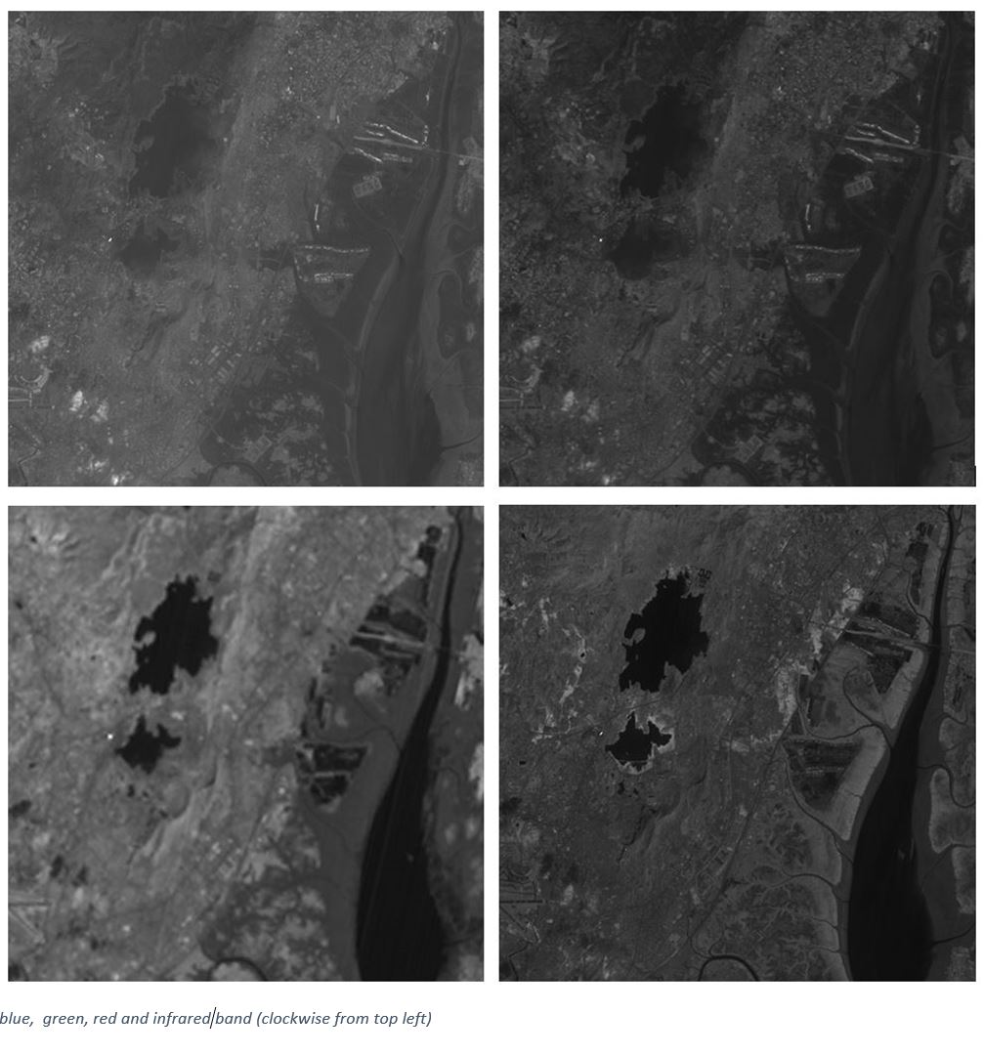
Problem statement
To segment and classify the given satellite image into one of seven classes depicting different terrains like water bodies, vegetation and man-made structures.
GIVEN DATA:
1. The satellite image data provided here is that of LandsatTM sensor.
2. Spatial resolution is 30m i.e. each pixel covers 30mx30m area on ground.
3. Size of the image provided is 1024pixels x 1024 pixels
4. Image covers powai area and its surrounding, a part of Mumbai city.
5. Data contains four bands viz. Blue, Green, Red and Infrared.
6. There are seven classes or categories in this image.
7. 10x10 Training window indexes for each class

Slide 3
CLASSIFICATION Approach
MOTIVATION | METHODOLOGY | IMPLEMENTATION | DEMONSTRATION

Slide 4
MOTIVATION
In statistics, maximum likelihood estimation (MLE) is a method of estimating the parameters of a statistical model given observations, by finding the parameter values that maximize the likelihood of making the observations given the parameters.
Intuitively, this maximizes the "agreement" of the selected model with the observed data.
The MLE algorithm is based on probability instead of other conventional algorithms (k-means) that uses distance measurements.
MLE is a suitable approach to estimate statistical parameters from a random sample of data.

Slide 5
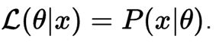
METHODOLOGY
ALGORITHM
The first step in MLE is to estimate the statistical parameters. The intensity value of the pixels belonging to a particular class are normally distributed, we compute the mean and standard deviation of the available samples for each class.
We then define our likelihood function of these parameters .The likelihood of a set of parameter values, θ, given outcomes x, is equal to the probability of those observed outcomes given those parameter values, that is
Since Gaussian distribution is a continuous probability distribution, P(x|θ) will be the probability density function of the normal distribution given by

Slide 6
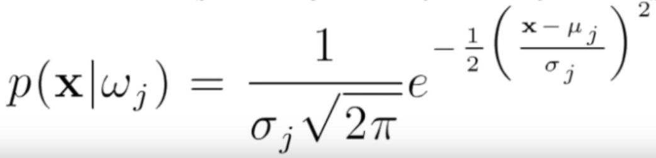
W_{J} = Class of pixel (j = 1,2,3,4,5,6,7)
P(X | W_{J} ) = Probability that pixel X belongs to class W_{J}
X = pixel intensity value
σ_{J} = Standard Deviation of class W_{J}
μ_{J} = Mean of class W_{J}
Finally, the pixel is assigned to the class which has the maximum likelihood / probability.

Slide 7
II. SPECTRAL BAND COMBINATIONS:
A multispectral image is one that captures image data at specific frequencies across the electromagnetic spectrum and not limiting itself to the visible light range.
The information for each specific wavelength range is stored as a separate image called band (red, green, blue, infrared).
Different band combinations highlight different parts of the image based on the terrain feature and wavelength of light.
After some trial and error ,the ideal spectral band combination for each class was found as:
CLASS ASSIGNMENT | BAND COMBINATION
1 | INFRARED-GREEN-BLUE
2 | GREEN
3 | RED
4 | BLUE
5 | GREEN-RED-INFRARED
6 | RED
7 | RED-INFRARED-BLUE

Slide 8
MERGED SPECTRAL BANDS
Green –Red-Infrared
Red-Infrared-Blue
Infrared-Green-Blue

Slide 9
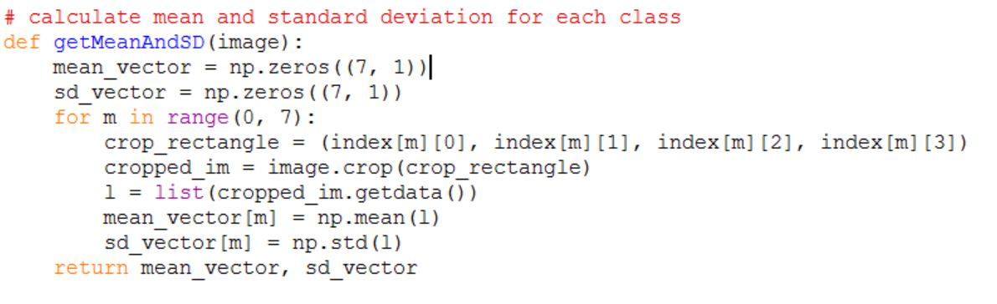
IMPLEMENTATION
The images are loaded in grayscale using the Image module in pillow package
The images are merged using the Image.merge() in RGB mode to obtain different spectral band combinations
The training window area for each class is selected and their pixel intensity values are obtained and stored as a list
The mean and standard deviation of the pixel intensity values is calculated using numpy.mean() and numpy.std() for each class and the result is stored in a 7x1 vector

Slide 10
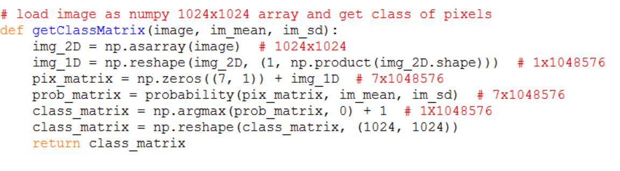
5. The class conditional density for each pixel of the satellite image is calculated using a vectorised form of the above
equation
The class with the highest probability is assigned to that particular pixel to obtain a 1024x1024 class matrix with values from 1 to 7 for each spectral band combination.
An image matrix ( 1024x1024x3) is built by initializing to Red band classification to cover mutually exclusive pixels and then assigning defined [R,G,B] colour constant for each class from appropriate spectral band combination and saved as ‘CLASSIFIED IMAGE.TIF’.

Slide 11
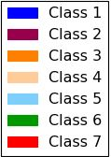
demonstration
In the classified output image each class is identified with a different colour as described by the legend.
Programming Language: Python 3
Modules required: PIL.Image, numpy, math
1. Run the merge.py script first to obtain required band combinations(GRI.TIF, RIB.TIF, IGB.TIF)
2. Run the segmentation.py script next to obtain the classified output image (CLASSIFIED IMAGE.TIF)
3. Run the accuracy.py script at the last to obtain algorithm accuracy in the output console

Slide 12
evaluation
CONFUSION MATRIX | KAPPA COEFFICIENT | OVERALL ACCURACY

Slide 13
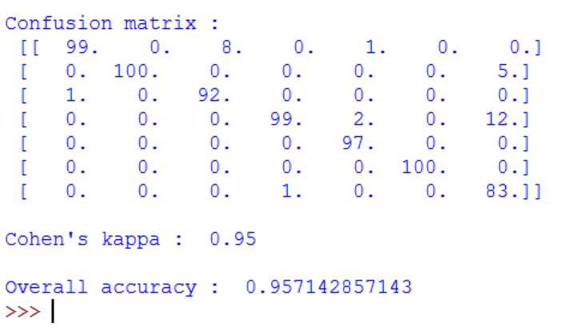
accuracy
The accuracy of the algorithm is computed against the training window in the unclassified and the classified image. The following 2 metrics were used to evaluate the accuracy of our classification model:
Kappa Coefficient
Overall Accuracy
To calculate the Cohen’s kappa and overall accuracy, we built the Confusion Matrix for our classifier. Each row of the matrix represents the instances in a predicted class while each column represents the instances in an actual class.
For example see the first column, our classifier predicted 99 pixels in class 1 and 1 pixel in class 3 out of the 100 pixels that actually belonging to class 1. The main diagonal of the matrix represents the correct guesses.

Slide 14
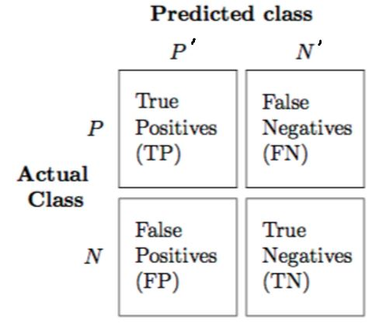
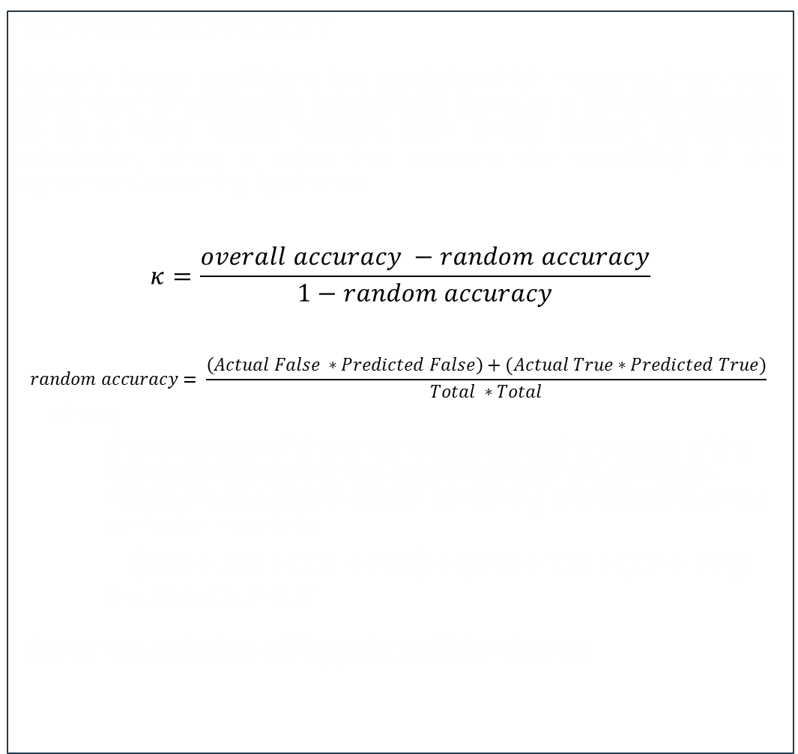
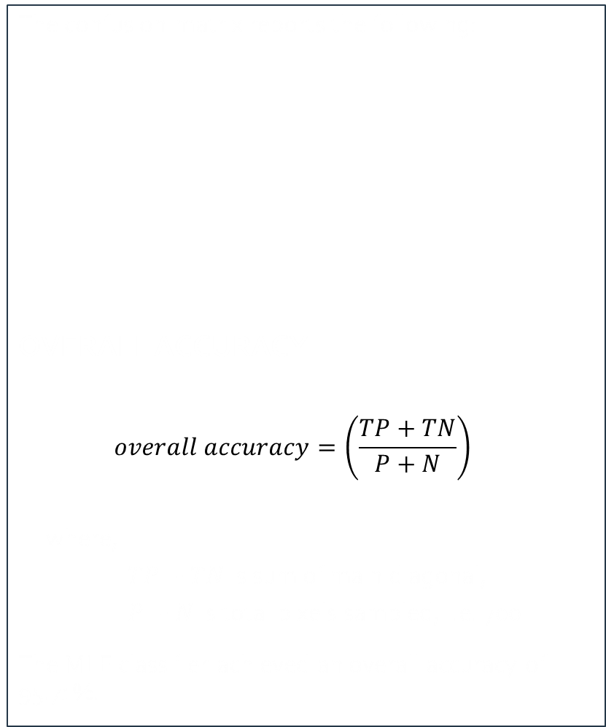
The confusion matrix reports the following:
OVERALL ACCURACY:
$$overall accuracy=\left(\frac{TP+TN}{P+N}\right)$$
where,
$TP+TN$ is sum of main diagonal,
$P+N$ is total pixels sampled, i.e. 700
The MLE classifier achieved an overall accuracy of 95.71%.
KAPPA’S COEFFICIENT:
Cohen's kappa coefficient is a statistic which measures inter-rater agreement for qualitative (categorical) items. It is generally thought to be a more robust measure than simple percent agreement calculation, since κ takes into account the possibility of the agreement occurring by chance.
$$κ=\frac{overall accuracy −random accuracy}{1−random accuracy}$$
$$random accuracy= \frac{\left(Actual False ∗Predicted False\right)+(Actual True∗Predicted True)}{Total ∗Total}$$
where,
the numerator of the random accuracy is the product of the row vector containing the column sums of the confusion matrix and the column vector containing the row sums of the confusion matrix i.e
$\left(\left(TN+FP\right)∗\left(TN+FN\right)\right)+(\left(FN+TP\right)∗(TP+FP))$
And $Total$ is $P+N$
The computed value of Kappa’s coefficient is 0.95.

Slide 15
conclusion

Slide 16
In order to segment the satellite image properly, selection of the most proper satellite image, spectral band combination, and the classifier are very important. The Maximum Likelihood Estimation classification model was able to achieve a 95.71% accuracy, which is suitable for most remote sensing applications.

Slide 17
Thank you!

